Slide 1
Electrical Trainings
MVRT 115 2016 - 2017

Slide 2
Welcome to Electrical!
Director of Electrical: Ishan Mitra
Subdivision Overview
Wiring
Lead: Sankalp Agrawal
Programming
Robot Code
Lead: Heather Baker
Vision
Lead: TBD
Let’s get started WOOOOOOOOO!!!!

Slide 3
Control Systems

Slide 4
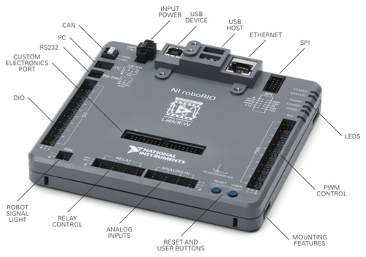
RoboRIO
Brain of the robot
Load code onto it
Sends signals to CAN chain and PWM
Has Digital and Analog In ports for sensors
Has port for signal light
Signals when robot has been enabled
Ethernet port to connect to router so that we can control robot
USB ports for devices (camera, etc.)

Slide 5
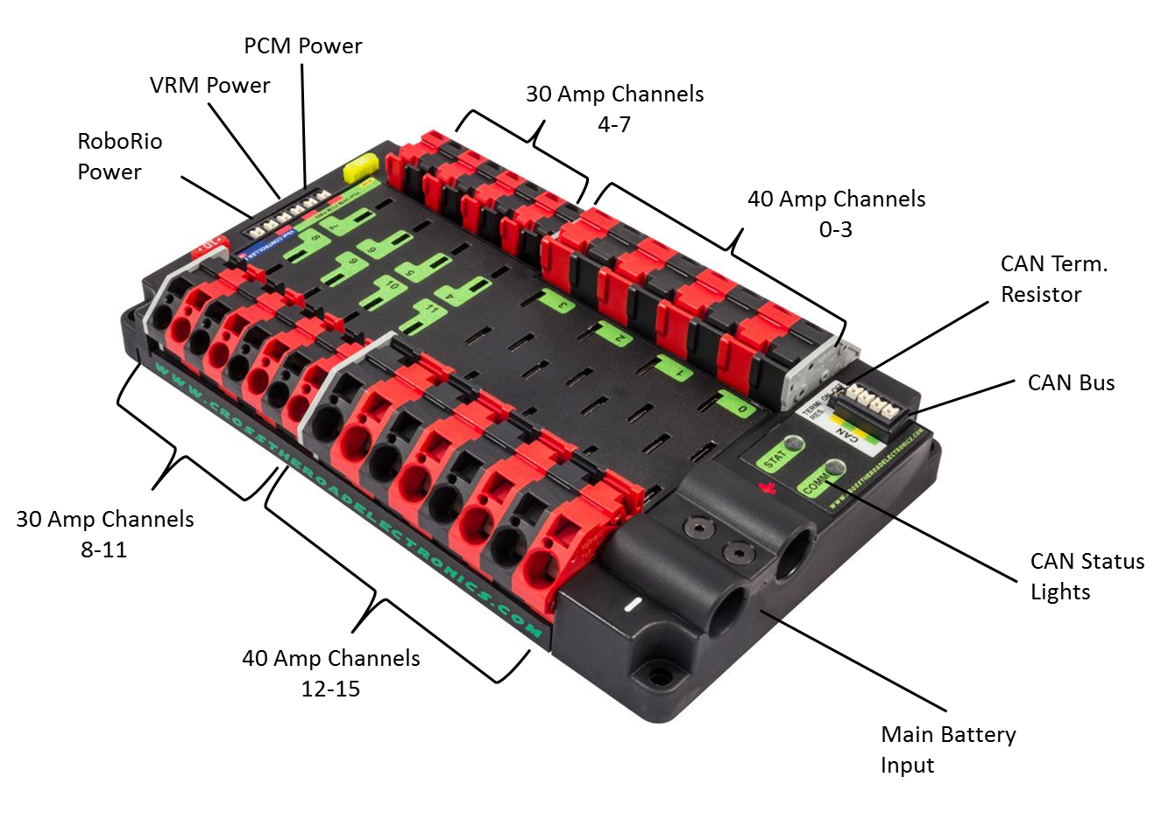
PDP
Power Distribution Panel
Distributes power from battery to rest of robot
Uses breakers to restrict how much power is sent
40 and 30 amp channels
Generally ends the CAN chain

Slide 6
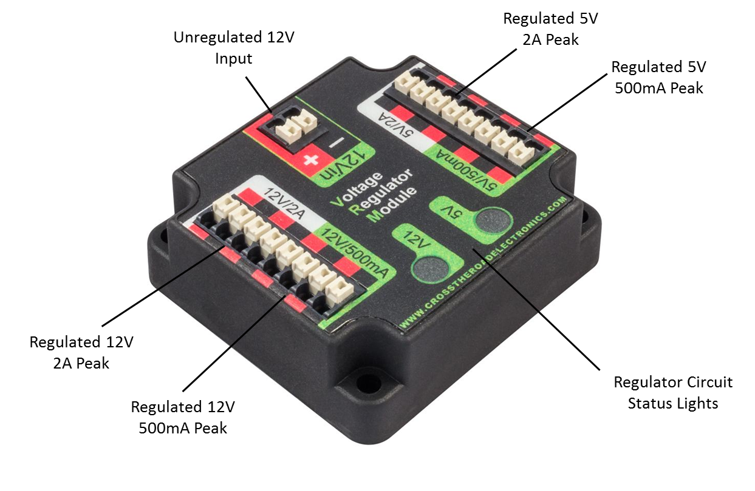
VRM
Voltage Regulator Module
Regulates how many volts travels to certain components
Router
Light Ring
Flashlight

Slide 7
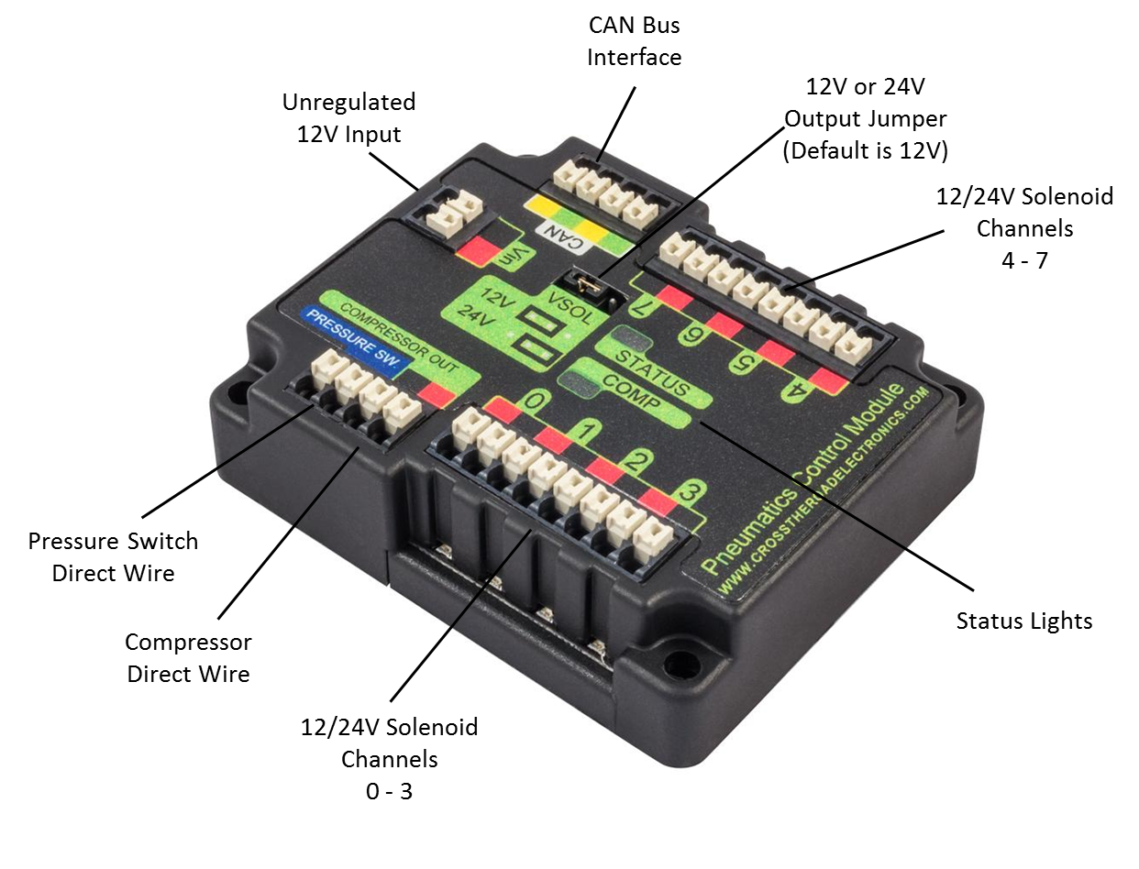
PCM
Pneumatics Control Module
Sends signals to solenoids to actuate pistons
Controls compressor
Contains 7 channels for solenoids
Works through CAN

Slide 8
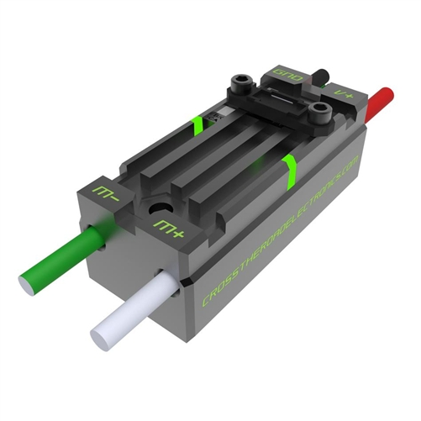
TalonSRXs & Other Motor controllers
Controls the speed of motors
Takes power from PDP and then restricts how much goes to the motors ultimately restricting speed
We use TalonSRX on a CAN Chain
TalonSRXs have special features that make them better than most other motor controllers
Smaller form factor lets them easily fit on the robot
Other motor controllers include
Jaguars
Victor SP
Talon SR (on 2012)

Slide 9
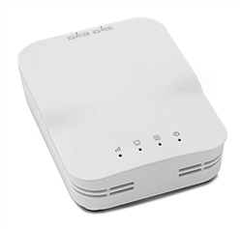
Router
Connects to VRM for power and RoboRIO to pass data
Onboard Wifi lets us connect to the robot and control it from a nearby computer
Must be configured at competitions
To work with the Field Management System (FMS)

Slide 10
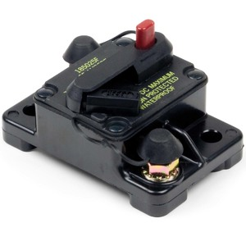
Main Breaker
Turns robot off and on
Push black piece in to turn on
Press big red button to turn off
Connects to PDP and Battery
Wires to positive side of both
Stops the flow of current if there is too much drawn

Slide 11
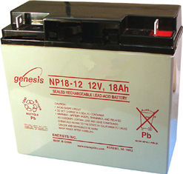
Batteries
12 Volts
Lead Acid (like a Car)
Power source of robot
Connects to main breaker and PDP

Slide 12
Checkup!

Slide 13
Sensors & Wiring I

Slide 14
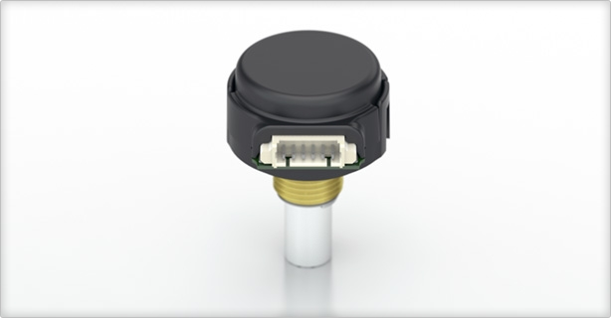
Encoders
Used to measure rotation
Connects to breakout board on Talon SRX
Gives us data in “ticks”, which we divide by ticks per rotation to get total rotations
Uses a black/white disc to determine ticks
Analog (between 0 to 1)
Helps orient the robot in games

Slide 15
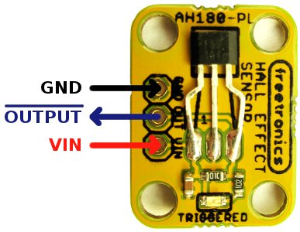
Hall Effect
Digital sensor used to detect the presence of a magnet
Works like a switch (on/off) but some can also have multiple values (analog)
By mounting a magnet on a moving component we can detect its position through multiple hall effect sensors
Plugs into digital pins on Rio

Slide 16
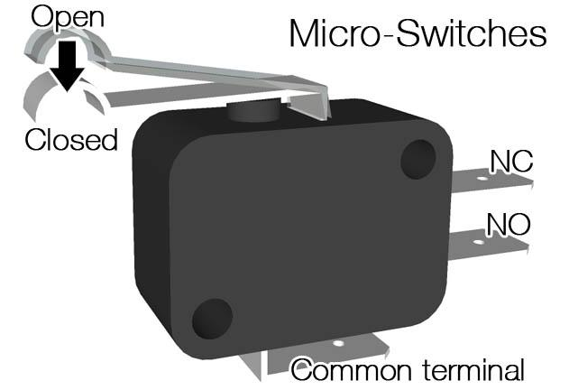
Limit Switches
Used to detect when a manipulator has reached an endpoint
Essentially just a small button
Plugs into digital input/output pin on Rio
Digital output (0 or 1)

Slide 17
Pneumatics

Slide 18
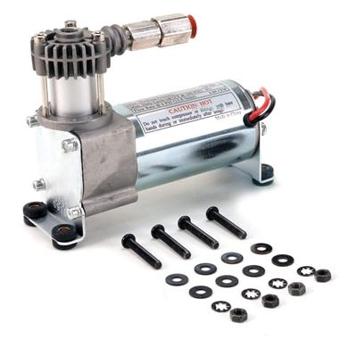
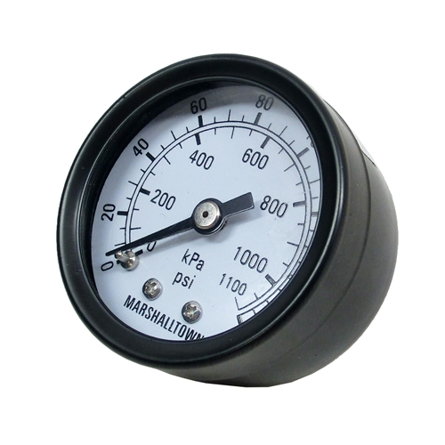
Compressor & Compressor System
Connects to air tank and pressure gauge
Compresses air to be used by pistons
Release valve relieves pressure

Slide 19
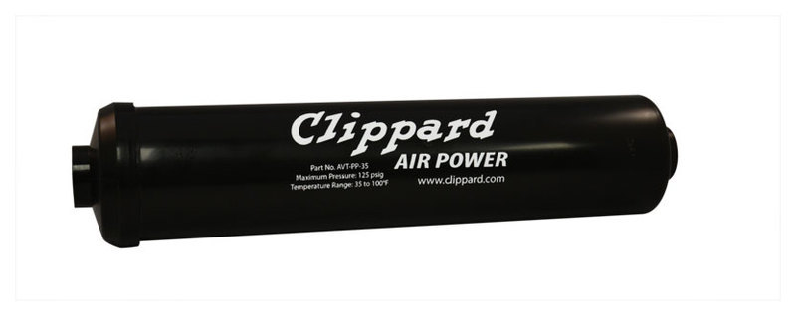
Air Tank
Lightweight tanks that hold compressed air
Can be chained together to hold more air

Slide 20
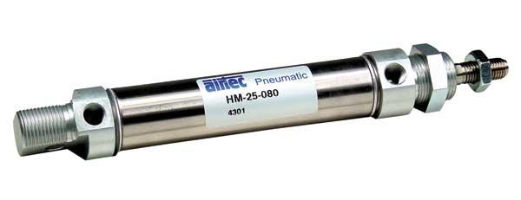
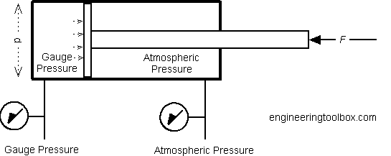
Piston
Fixed length
Can only extend or retract (2 positions)

Slide 21
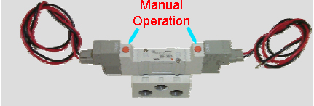
Solenoid
Receive signal from PCM to extend or retract piston
Can manually extend and retract piston

Slide 22
Wiring II

Slide 23
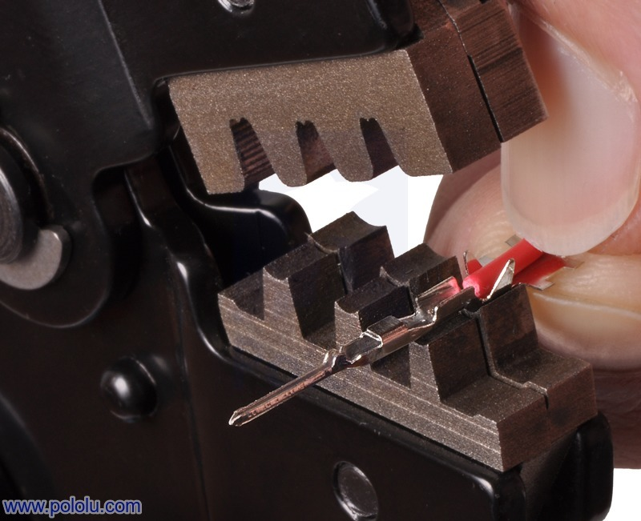
Crimping
Attaching housings to bare wire
Allows us to make reliable and clean connections
Different types for different purposes
PWM for signal
Powerpole for power
Flag for motor connections (don’t use too much)
Ferrules for connections to VRM, PDP, Roborio, etc.

Slide 24
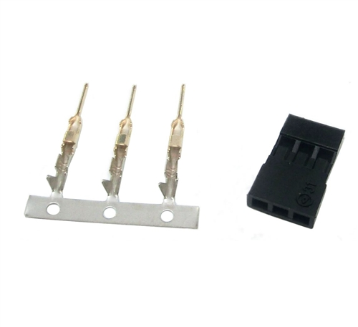
PWM
The smallest and hardest crimps
Used for signal wires
Encoder readings
Break beam readings
Used for CAN chain in talons (also signal wires)

Slide 25
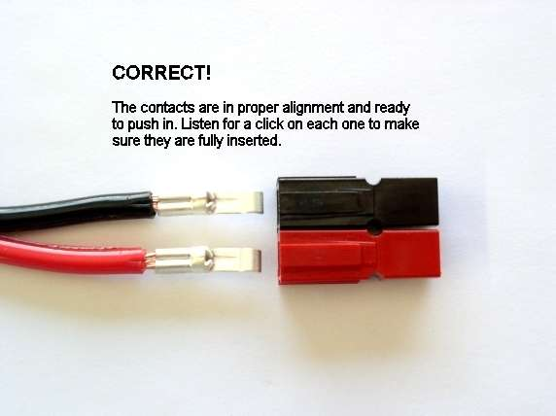
PowerPole
Large and relatively simple crimps
Used for power delivery to Talons, Motors, and some miscellaneous components.

Slide 26
Intro to Java

Slide 27
Wut is that?
Programming Language
Converses with machines
Java is a high-level Object Oriented Programming (OOP) Language
Easily understood by humans then converted to binary for machine
Object Oriented → Define different “objects” in code and their “attributes”
Bird object → attribute: can fly

Slide 28
How do I become a programmer???
You need…
An Integrated Development Environment (IDE)
Eclipse is what we use for robotics
The JVM (Java Virtual Machine)
Download the latest JDK (Java Development Kit) from Oracle
Now you’re ready my frands!!!

Slide 29
Ok… How do I make it do stuffs?
Java is a language
Similar to English, Spanish, and French
Has it’s own “rules” known as syntax
Basic Syntax
Sample Program

Slide 30
Data? Wat types?
Primitive Data Types
Integers
byte
short
int
long
Floating Point (Decimals)
float
double
Logic
boolean
Letters
char

Slide 31
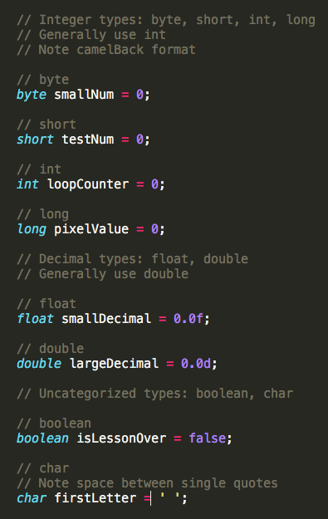
How do I use them in code?

Slide 32
What can I do with variables?
You can do common mathematical operations
Add (+)
Subtract (-)
Multiply (*)
Divide (/)
You can also use some unique operations
Modulus (%)
You can compare to boolean values
Equal to (==)
Not equal to (!=)
! → Not

Slide 33
Constants
Values that do not change
final int MY_CONSTANT = 5;
Naming convention for Constants is all caps

Slide 34
Practice program

Slide 35
Methods
Input
Methods do things
Methods are run when they are called
Creating:
AccessSpecifier returntype methodName(parameters) { Do Something }
Calling:
methodName(parameters)
Do Something
Output

Slide 36
Method Name
Naming convention: Camelback
First letter lowercase, other letters that begin a word are uppercase
Eg:
getName()
printString()

Slide 37
Return type
Value returned by the method (the output)
If no return value, the type is void
Return types can be the data types or objects
int
double
float
String
char

Slide 38
Parameters
Optional: Input for the method
When a method is called, can pass in values
Method can utilize these values
Ex
printString(“Hello”);

Slide 39
Practice Program

Slide 40
Classes
In real world, there are individual objects of the same kind
For example, there are lots of cars, but they’re all cars
The cars were built from the same general blueprint
A class is a blueprint from which objects can be created
Within a class, there are variables and methods defining the blueprint
For a car
Variables: numOfWheels, maxSpeed
Methods: drive, stop, turn

Slide 41
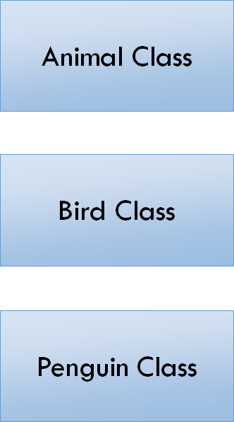
Inheritance
Method: Eat
Super Class/Parent Class
Sub Class
Inherits Information
Polymorphism
Difference between Subclass and Parent Class
Method: Fly
Var: Legs = 2
Wings = 2
Method: Swim

Slide 42
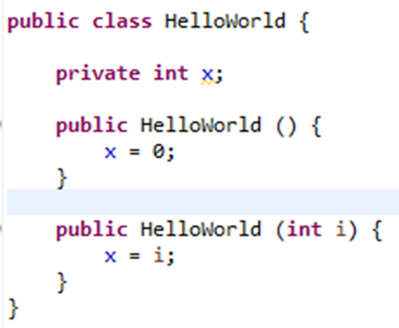
Constructor
Special method used to create an object
Constructor has the same name as the class it is in
Often contains variables to initialize
public Classname( parameters ) { initialize stuff }

Slide 43
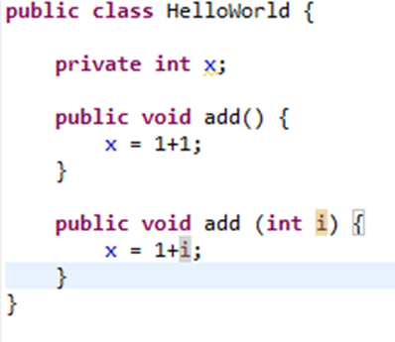
Overloading
Methods with the same name but different parameters

Slide 44
WPILib

Slide 45
FRC Command Based Robot
Subsystems
Define different systems of the robot
Commands
Define operation of the robot using capabilities from subsystems
Operator Interface
Defines buttons and axes of joysticks and maps presses to commands
Robot
Schedules the actions of the robot (commands)
Transitions between modes (Disabled, Auton, Teleop)

Slide 46
Subsystem
The different parts of the robot
Subsystems extend the Subsystem class
Examples of Subsystems
DriveTrain
Elevator
Arm
Flywheels

Slide 47
Robot
Contains methods to control the states of the robot and what happens
robotInit
autonInit/Periodic
teleopInit/Periodic
disabledInit/Periodic
Iterative robot
Loops through method multiple times, updating each time
Contains objects of the subsystems

Slide 48
Commands
A set of instructions that will move parts of the robot or trigger reactions
Child classes of Command
Commands run when buttons are pressed, or when scheduled by other actions
CommandGroup - Group of commands that run simultaneously or sequentially
No
Wait for data
Initialize
Execute
IsFinished
Exit
Yes
Yes
Yes
Yes

Slide 49
OI
Operator Interface
Maps buttons to commands for the robot
Button pressed? do this
Button toggled? do this
Trigger pulled? do this

Slide 50
Motor Controllers (CANTalon)
Control the output to the motors
CANTalons have special features
Built in control loops
Special interface for sensors (FeedbackSensors)
Multiple control modes
Speed, Position, etc.
Used in any Subsystem that uses motors

Slide 51
WPILib Pneumatics

Slide 52
Double Solenoid
Solenoids actuate pistons forward and backwards
DoubleSolenoid class has two modes (extend and retract)
Requires A and B channels (air in, air out)

Slide 53
Compressor System
Compresses air for the robot
Needs the id of the PCM
Can be turned on and run throughout match, or only once

Slide 54
WPILib Sensors

Slide 55
Digital Input/Output
Digital = 0 or 1/yes or no
Connects to DIO on roboRIO
Digital Input/Output requires port number
Use get() method to get the value of the sensor
Sensors include: Limit Switches,

Slide 56
Analog Input/Output
Analog = between 0 and 1
Ex.
0.1, 0.5, 0.635, 1, 0, 0.124568241, etc.
Plug into Analog Input on roboRIO
Requires port number

Slide 57
Encoder

Slide 58
TalonSRX Feedback sensors

Slide 59
Advanced Coding (Strongback)

Slide 64
Debugging

